Slide 1
PDR Electrical Power System with Maximum Power Point Tracking (MMPT)
Lead Engineer: Elijah Gibbs
Manager: Jeffrey Kruth
Technical Advisor: Nate Fite

Slide 2
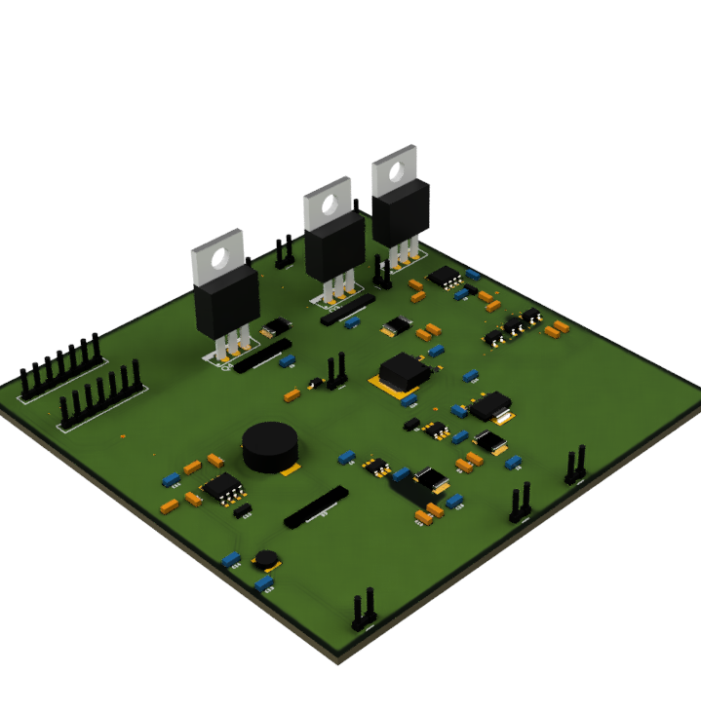
Project Description
Design and Test a full electrical power system(EPS) for a CubeSat
The project will encompass all steps of the EPS from input specifications to output considerations
Will also consider the implementation of an MPPT input design.
Goal is to have this design function for a 1U-3U CubeSat

Slide 3
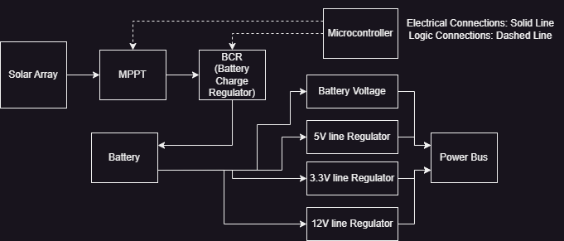
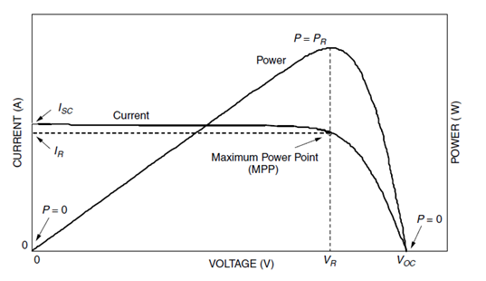
System Level Design
There will be two boards:
A board for the batteries and battery management
A board for all other EPS functions:
MPPT
BCR
Output Regulation
Microcontroller

Slide 4
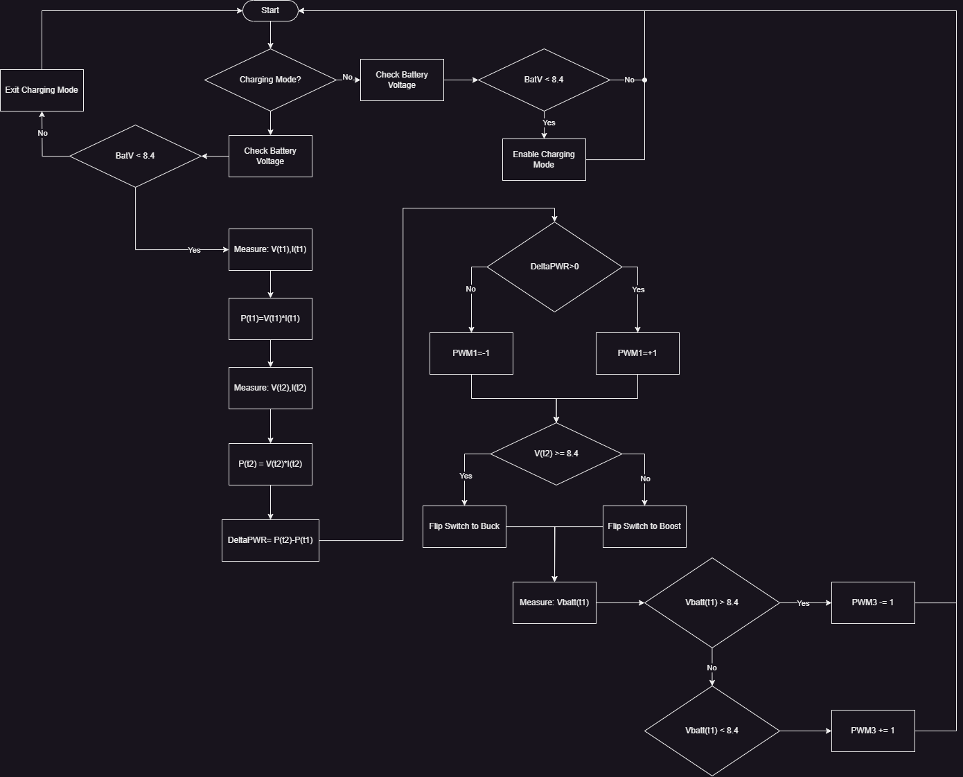
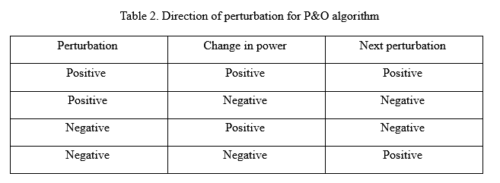
Software Flowchart

Slide 5
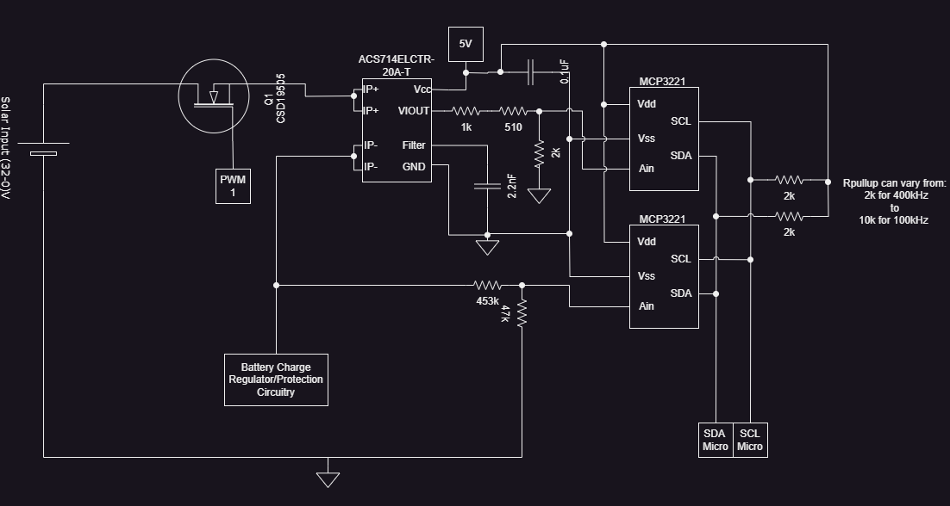
MPPT
MPPT can intake:
An input voltage range up to 30v
An input current range up to 20A
System will use FET to traverse the I-V curve.
Will use perturb and observe method find peak power

Slide 6
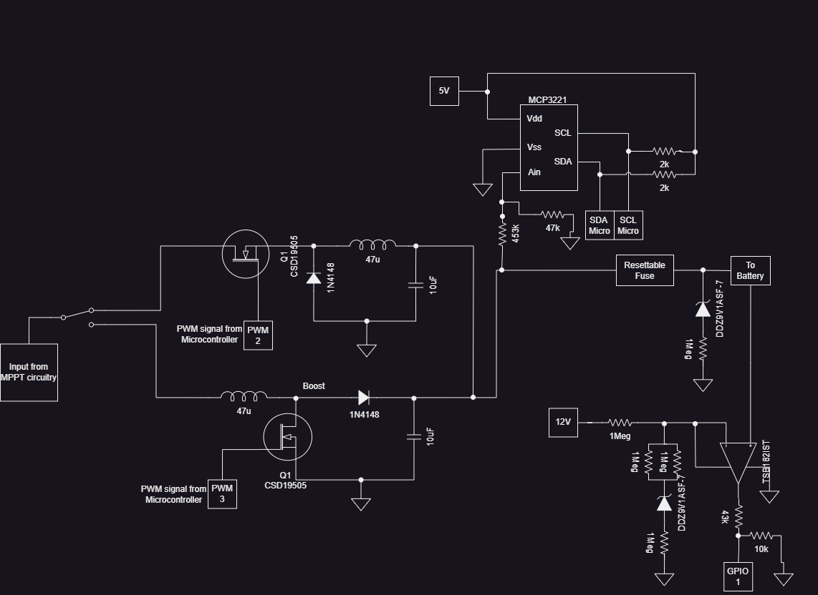
Battery Charge Regulator
Will utilize buck/boost setup to convert power to battery level
Will switch between buck and boost convertor depending on needed power input needs
Will use Zener Diode to stop overvoltage spike
Will use fuse to stop overcurrent spikes
Will use comparator setup to detect when to stop charging

Slide 7
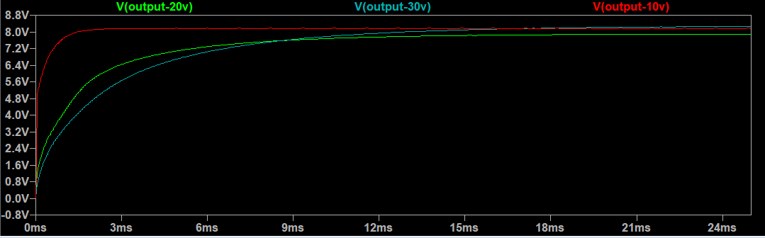
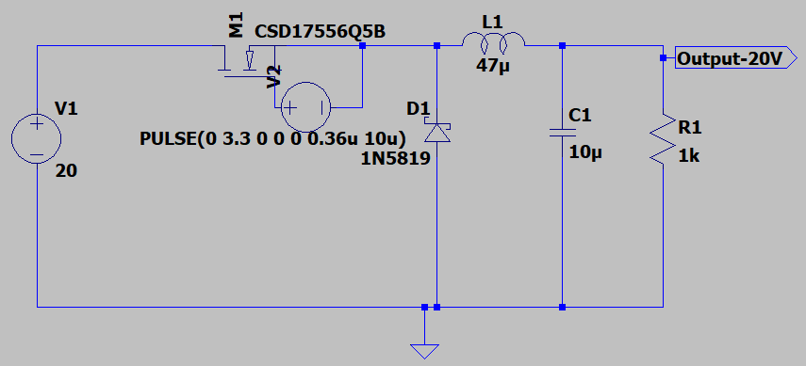
Tested over several cases all cases can be adjusted to within 8.4V
No major anomalies to contend with
LtSpice Buck Convertor

Slide 8
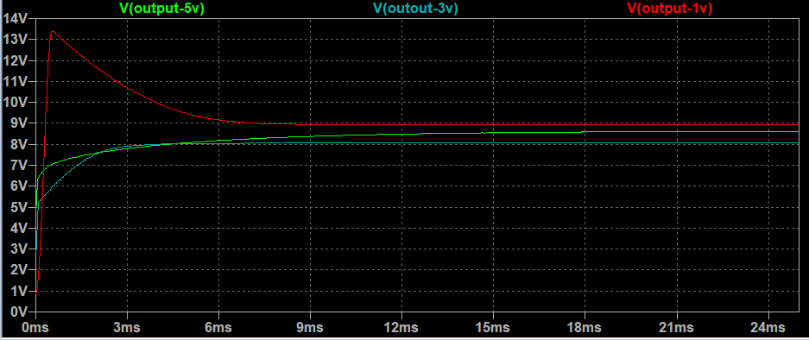
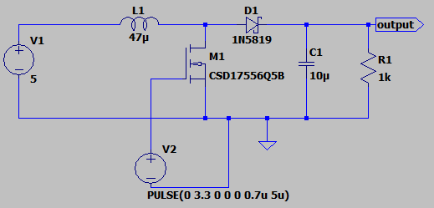
LtSpice Boost Convertor
Tested over several cases all cases can be adjusted to within 8.4V
Voltage spike on 1V is tolerable due to Zener diode voltage clamp after boost convertor.
May also look to add capacitor before inductor to reduce overvoltage spike.

Slide 9
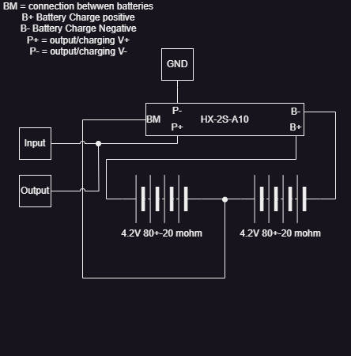
Battery Layout
Will utilize two series setup.
4.2V batteries at 5000mAhrs will provide 42Whrs of power
HZ-2S-A10 will function as a Battery Management System Protection Board

Slide 10
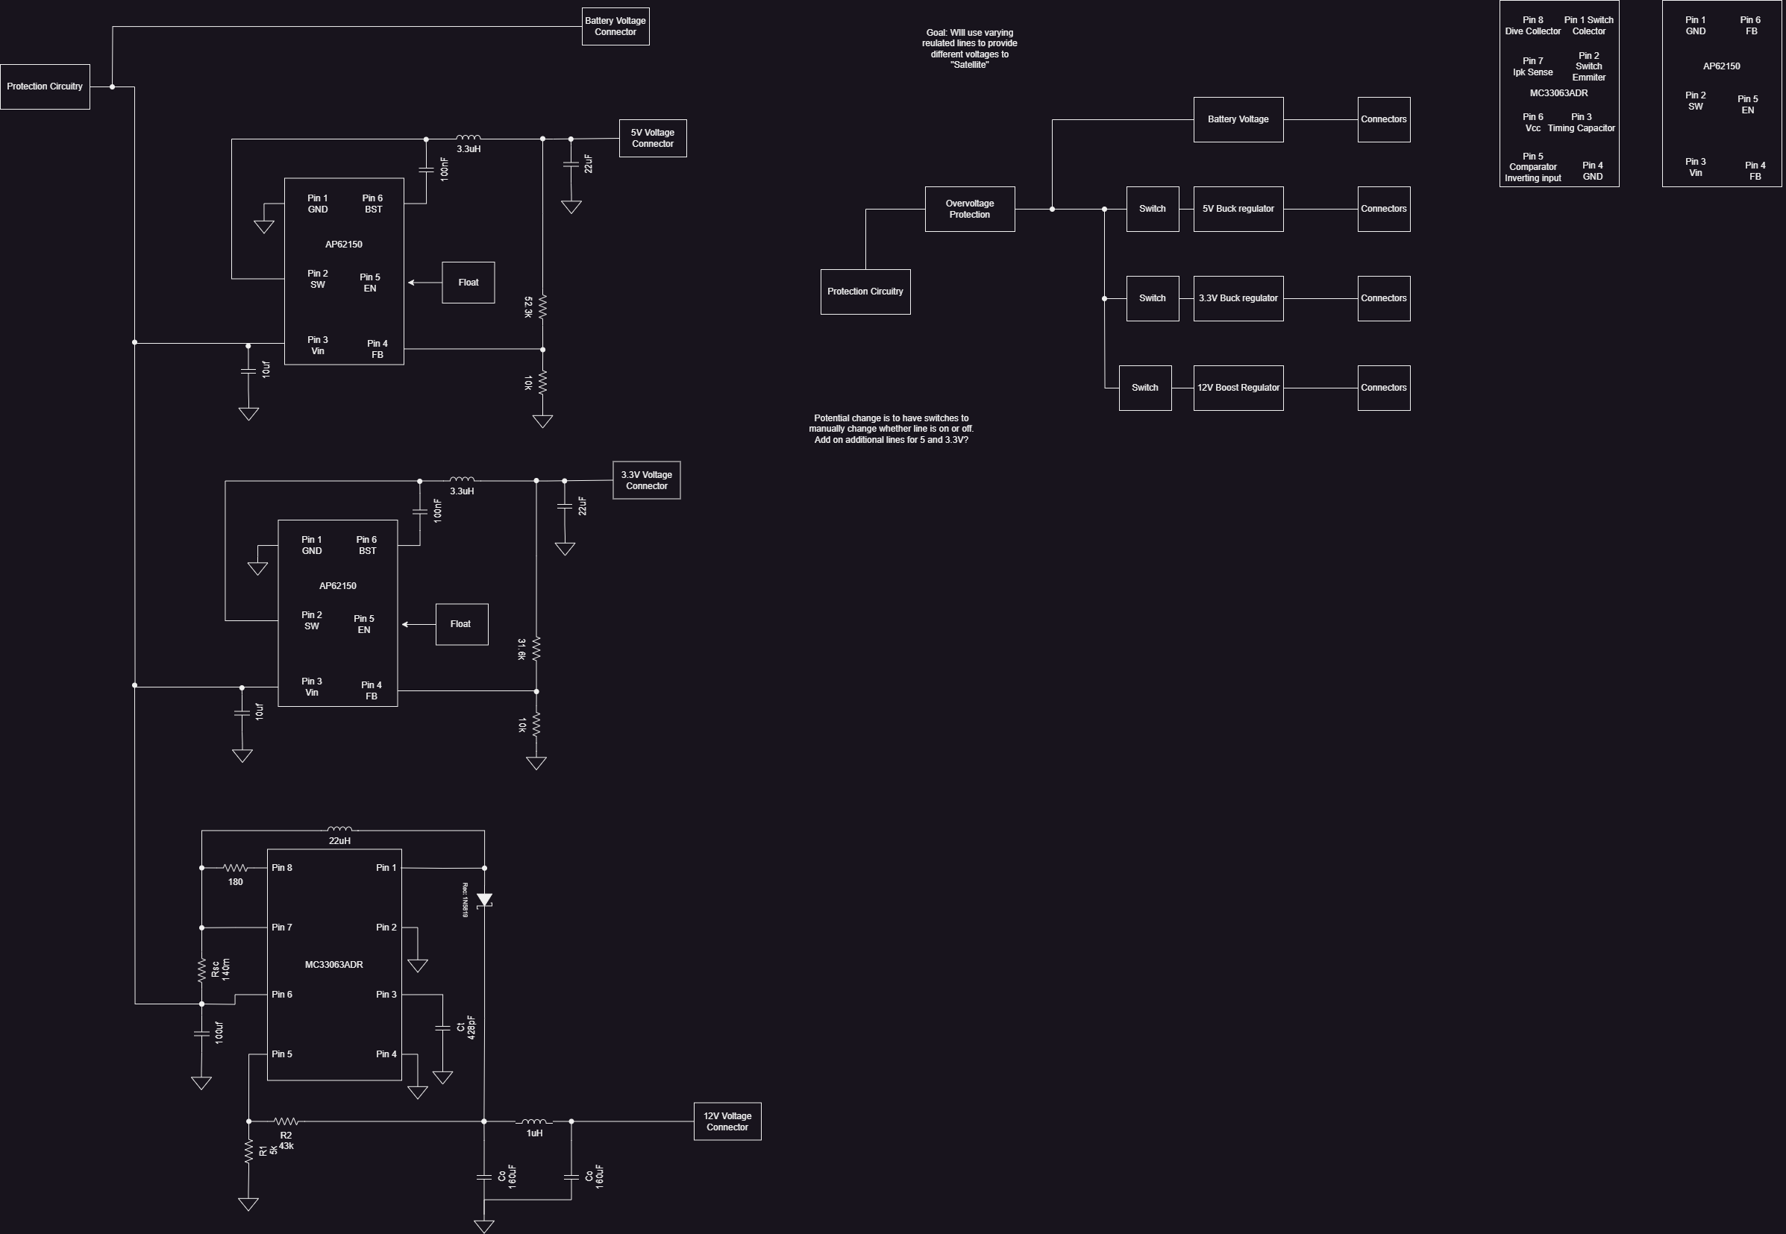
Regulated Lines/Output
Will provide regulated output using switching regulated buck and boost convertor ICs.
Lines available 3.3V @ 1A, 5V @ 1A, 12V @ 1A, Battery Voltage.
Will include switches to turn off individual lines to conserve power when needed.
For testing output can use a programable DC load

Slide 11
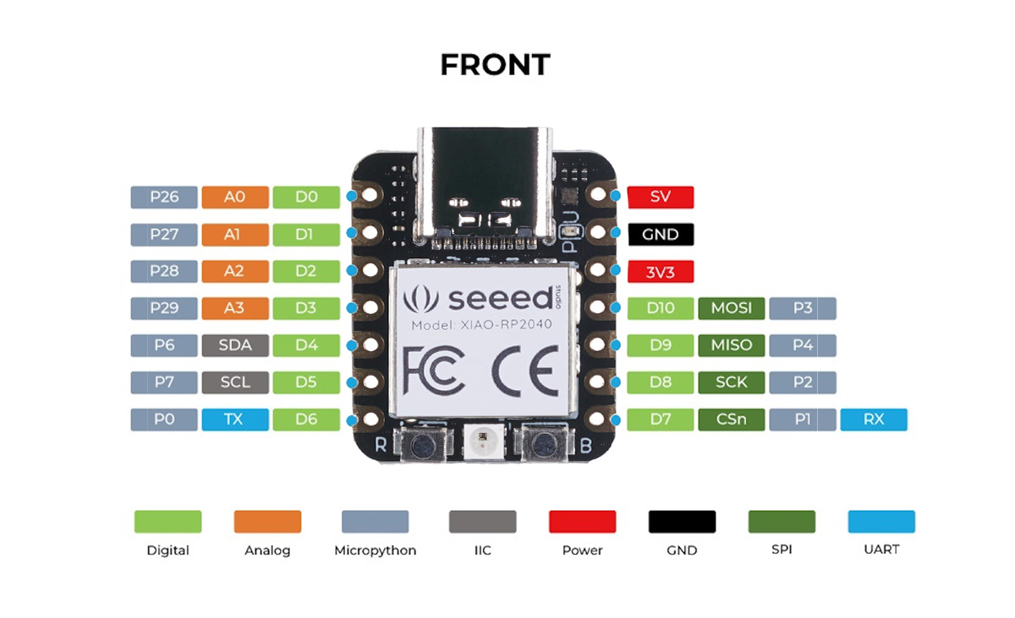
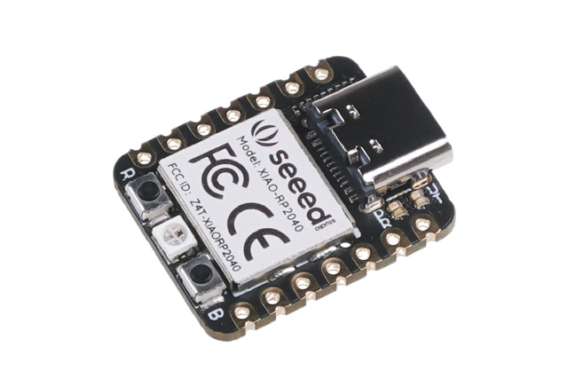
Microcontroller
SEEED STUDIO XIAO RP2040
ARM® Cortex®-M0+
2 Cores in CPU
Clock Speed is 48MHz
Normal Current: 28.9 mA
Functions
Monitor voltages at key points in system
Adjust voltages through PWM channels to FETS

Slide 12
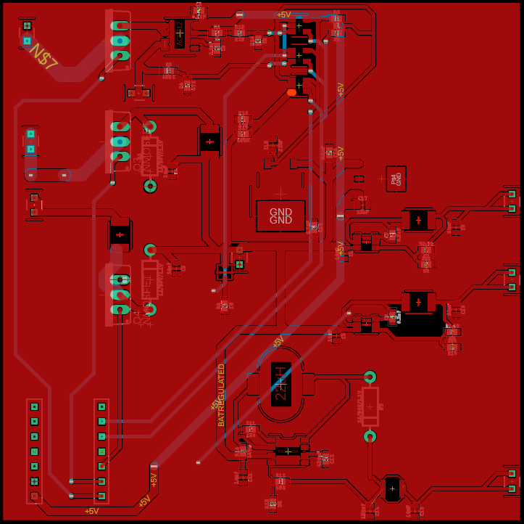
Main PCB Layout
Size will me 90mm x 90mm
Path widths:
0.508mm for data lines
1-2mm for power lines
2oz/sqft of copper
2 layers PCB

Slide 13
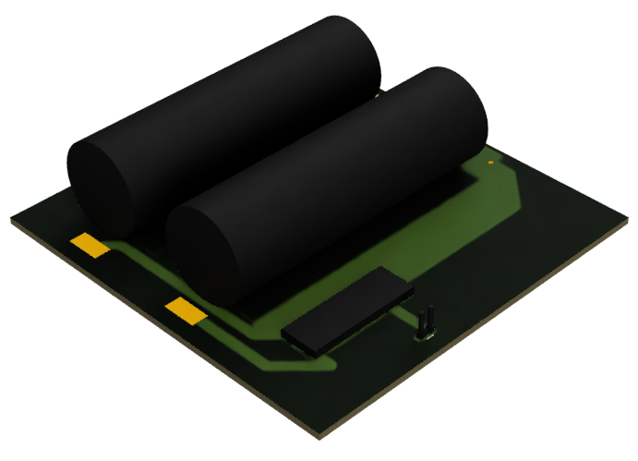
Fusion Model
Current Models on Left
Fabrication will be done in house at the space science center for the first few prototypes will be using RO4003C from Rogers Corp.
Final design will be manufactured from company – PCBWay
Will have a battery board and an main EPS board.

Slide 14
Project Requirements
Build an EPS that shall:
Generate power from solar array
Utilizes a MPPT structure to allow for maximum power to be gathered
Regulate power going in and out of the batteries
Take power from batteries and regulates it to a 3.3V regulated line, 5V regulated line and 12V regulated line.
Ensure power is distributable to multiple other systems
Have onboard microcontroller to control and monitor EPS with sensors

Slide 15
Resources
Parts: Suppliers like DigiKey, Mouser Electronics, and free sampling from Coilcraft, KEMET, STmicro, TI, Rogers, etc.
Software: LTspice (circuit simulation), draw.io (circuit and block diagram design), Fusion 360 (3D modeling/PCB design), Python (programming).
Tools: Soldering iron, oscilloscope, multimeter, current supply, DC load, and general electric items (available in SSC labs).

Slide 16
Risks
Programmatic:
Acquiring parts/Replaceability
Part Costs
Lead Times
Items that slow down the project
Technical:
Heat distribution
Current/Voltage limits
Generating Electric/Magnetic Fields
Electrostatic Shock
Requitements that need to be met

Slide 17
Budget
Direct Cost |  |  |  |  |  |  |  |  |  |  | Indirect Cost
Labour |  |  |  |  | Materials Cost |  |  |  |  |  | Items: | Office Supplies | Building Costs | Licenses | Other
Title | Hourly Wage ($) | Hours | Total Cost |  | Task | Progress | Expected Cost | Actual Cost | Under/Over |  | Budgeted: | 2500 | 10000 | 1000
Project Lead Engineer | 40 | 91 | 3640 |  | MPPT | Complete | 20 | 10.8834 | -9.1166 |  | Actual | 2500 | 10000 | 545
Technical Advisors | 100 | 11 | 1100 |  | Batteries | Complete | 25 | 19.749 | -5.251 |  | Under/Over | 0 | 0 | -455 | 0
Project Manager | 120 | 10 | 1200 |  | Battery Regulators | Complete | 15 | 10.086 | -4.914 |  | Total | 13045
 |  | Total of All | 5940 |  | Output Regulators | Complete | 10 | 8.1052 | -1.8948
 |  |  |  |  | Microcontroller/Supporting | Complete | 30 | 23.46 | -6.54
 |  |  |  |  | Spare Parts | Complete | 100 | 130.6064 | 30.6064
Total Costs of Project ($): | 19187.89 |  |  |  | Total Actual Cost |  | 200 | 202.89 | 2.89
Overbudget slightly due to buying extra spares.
Will allow for mistakes to be made in prototyping

Slide 18
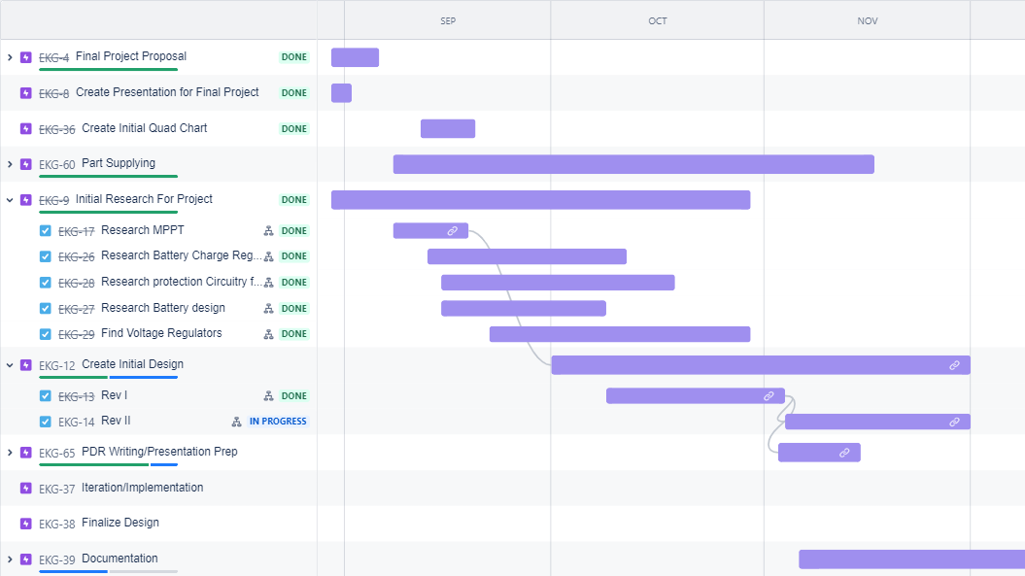
Timeline / Endpoint
Estimate for time to complete was at roughly 240 hours, Currently have spent 91 hours in total.

Slide 19
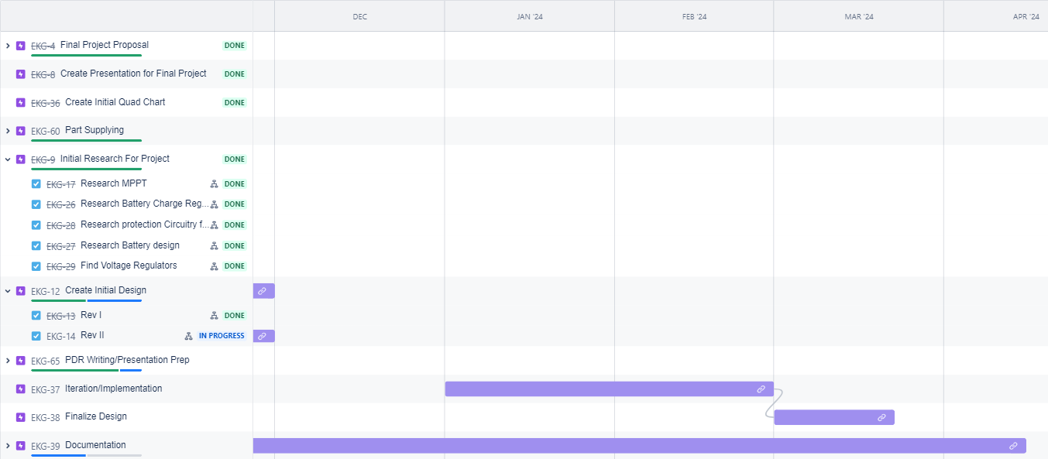
Endpoint/Going Forward
Next Steps:
Manufacture PCB
Populate and Test PCB
Start Iteration Processes
Endpoint :
The endpoint of this project is to be a functional brass board and PCB design.

Slide 20

Questions?

Slide 21
Unused Slides Below

Slide 22
Why am I qualified to do this?
Applicable Experience:
Worked as Embedded HW Engineer Intern over the summer
Have enhanced my knowledge in electrical systems
Have enhanced my knowledge in software systems
Education:
Space Systems Engineering
Gained a fundamental understanding of electrical systems within the context of space technology.
Through classes such as: Circuits, Spacecraft Electronic Systems, RF Transmission Lines & Circ.
Minor in Computer Science:
Gained hands-on experience in coding, software design, and problem-solving.
Overall:
With all these areas combined I have acquired a well-rounded skill set capable of taking on the challenges of this project.
Notes:
Mention Classes

